Slide 1




Blockchain for
climate action
toucan.earth
Michalis Kargakis

Slide 2
At Toucan, we're building the digital rails for climate finance.
We’re doing this by creating a globally accessible platform that efficiently connects buyers and suppliers in the voluntary carbon market.

Slide 3
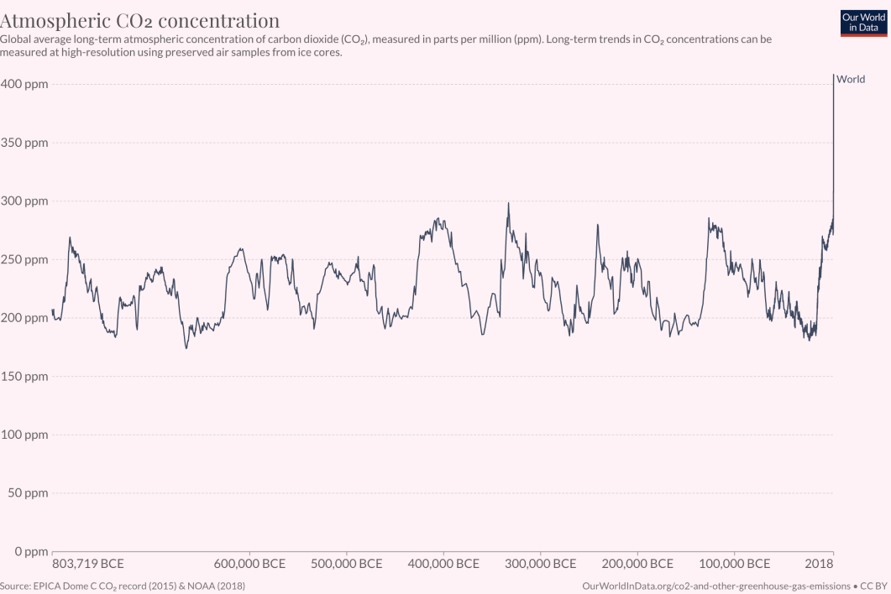
THE PROBLEM
We need to rapidly coordinate a response to our species' greatest challenge
The worst bull run
For too long, harmful practices have freely continued while our economic system fails to accurately price negative externalities.

Slide 4
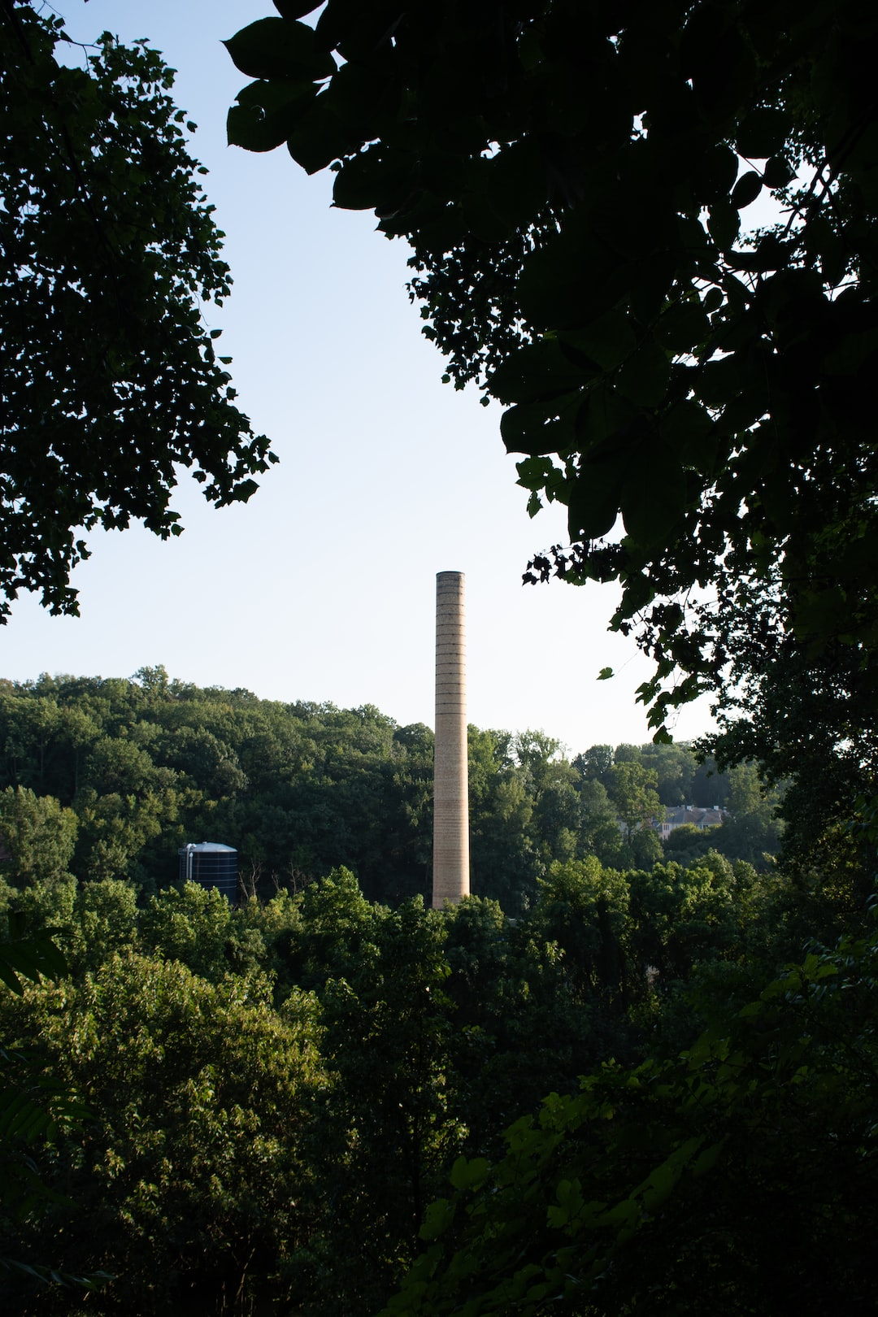
ONE SOLUTION
Carbon markets exist to put a price on polluting the atmosphere.
﻿
They are a market-based mechanism designed to incentivize the transition to a green economy.
Sources: [1] https://analytics-polygon.sushi.com/

Slide 5


MARKET
Types of carbon markets
EU ETS, RGGI, etc.
Legally binding for emission reductions. Guidelines establish which sectors must participate in these schemes.
COMPLIANCE
VCS, GS, Puro, etc.
VOLUNTARY (VCM)
Trade credits on an optional basis.
The project developer decides under which standard they want to participate and must comply with the guidelines of the selected standard.

Slide 6
MARKET
History of carbon markets
1994
2005
US trading schemes to control sulfur dioxide emissions (SOX, NOX)
Verified Carbon Standard (VCS)
1997
2015
Clean Development Mechanism (CDM) adopted under the Kyoto Protocol
Paris Agreement
2003
2021
Gold Standard for CDM (GS-CER) by WWF
China ETS
2005
2021
EU ETS (world's first)
Toucan brings carbon on the blockchain

Slide 7

MARKET
Carbon markets are growing rapidly
$147
$50 B: Projected VCM value by 2030¹
Target price per tonne CO2e by 2030¹
$2 B: VCM volume by August in 2022³
Already 100% more than previous year
100x
$1 B: Annual VCM volume in 2021⁴
Target VCM demand growth by 2050²
Sources: [1] https://www.unepfi.org/wordpress/wp-content/uploads/2021/07/FINAL-AOA-Discussion-paper-on-governmental-carbon-pricing.pdf [2] https://www.mckinsey.com/capabilities/sustainability/our-insights/a-blueprint-for-scaling-voluntary-carbon-markets-to-meet-the-climate-challenge [3] https://climatetrade.com/voluntary-carbon-market-value-tops-us2b/ [4] https://www.ecosystemmarketplace.com/articles/press-release-voluntary-carbon-markets-rocket-in-2021-on-track-to-break-1b-for-first-time/

Slide 8





MARKET
But capital isn't efficiently flowing to impact projects.
SUPPLY
MIDDLEMEN
MARKET
MIDDLEMEN
DEMAND
BUREAUCRATIC
HARD TO ACCESS
OPAQUE PRICING
FRAGMENTED
Sources: [1] https://analytics-polygon.sushi.com/

Slide 9
MARKET
Today's carbon markets are not ready to scale climate finance to meaningful levels
Inefficient supply
Fragmented markets
Opaque pricing
Very burreucratic, slow (eg., it takes ~5 years for Verra to issue credits)
Credits have a wide variety of attributes across many different standards and registries. This silos markets and limits liquidity
Manual, OTC
Not user friendly for retail
Lack of transparency results in intermediaries capturing 50-80% of value
Exclusivity limits carbon market access, holding back participation and keeping the price of carbon too low

Slide 10

Techology can help us build better carbon markets.

Slide 11
With Toucan’s data and liquidity tools, buyers can confidently assess risk and easily buy and retire credits.
These same products help project developers unlock instant liquidity for their credits, and tell their story.

Slide 12




Tokenized carbon credits transform the market
Tokenized carbon instantly reduces bureaucracy, and opens a frictionless global carbon market that's available to all.
SUPPLY
MARKET
DEMAND
SELF SERVE
OPEN TO ALL
UNIFIED LIQUIDITY
GLOBAL PRICE DISCOVERY
Sources: [1] https://analytics-polygon.sushi.com/

Slide 13




TECHNOLOGY
Meet the Carbon Stack,
everything needed to unlock newfound carbon credit utility.
Toucan Bridge
Toucan Meta Registry
Carbon Pools

Slide 14
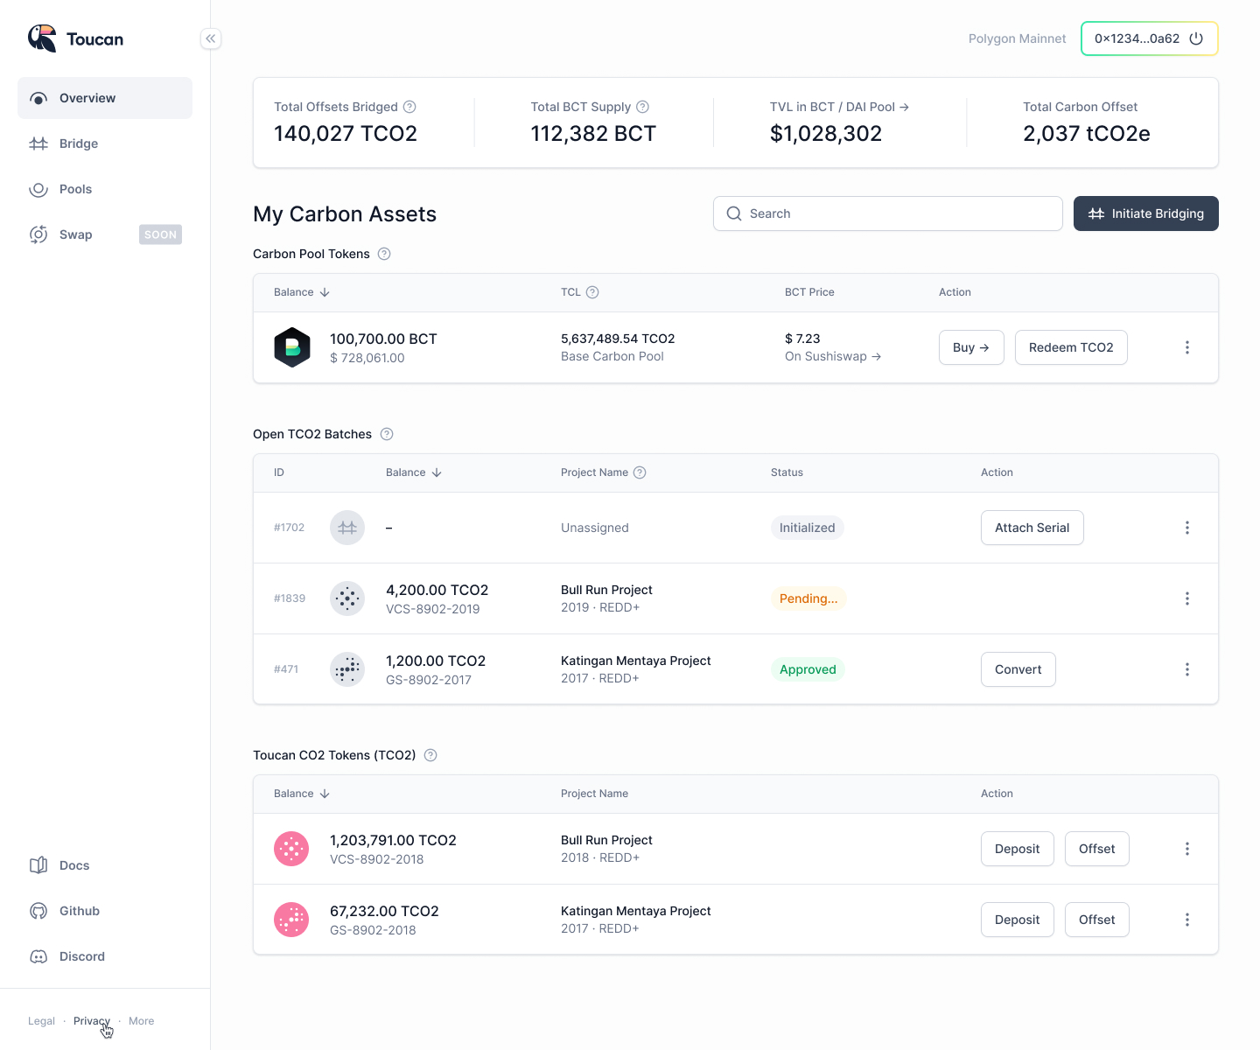
TECHNOLOGY
Toucan Bridge,
the gateway to programmable carbon
The Toucan Bridge enables the journey from carbon credit to tokenized asset. For each credit bridged, one Toucan CO2 (TCO2) token is minted. TCO2s are semi-fungible and retain credit-specific attributes and metadata.

Slide 15



TECHNOLOGY
Toucan Meta Registry,
a sink for carbon credits sourced from registries throughout the VCM
The collection of TCO2s in circulation make up the Toucan Meta Registry — a unified home for credits that helps to standardize data and simplify accounting.

Slide 16
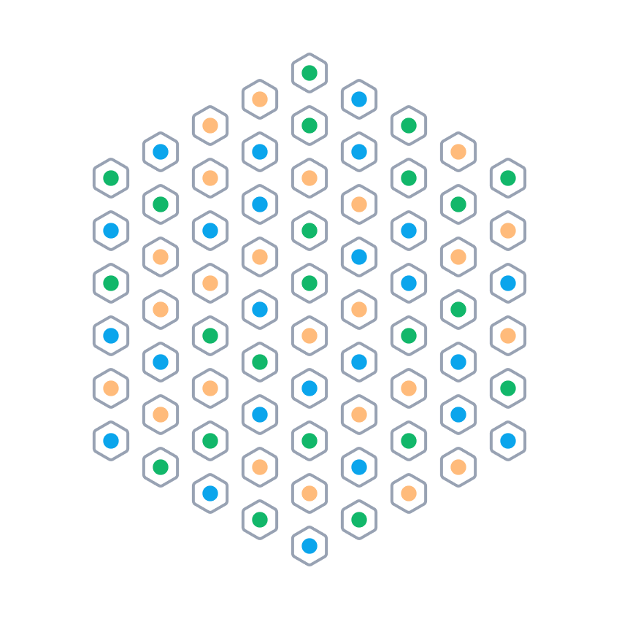

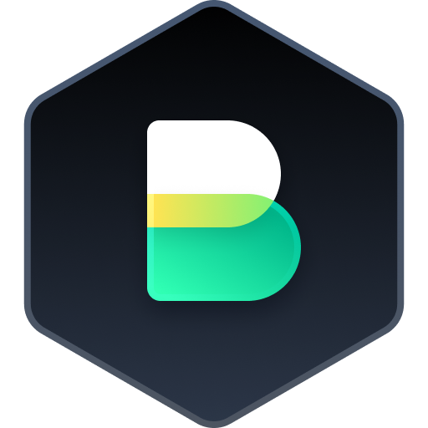
TECHNOLOGY
Say hello to ultra liquid carbon markets —
enabled by Carbon Pools
Carbon Pools are designed to attract tokenized carbon credits that share environmental project attributes.

Slide 17

USE CASES
What can be built?
On-chain carbon opens opportunities for a radically new system — one where economics and ecology align.
Carbon Project Explorer
Climate Impact
Dashboards
Retail Offsetting
Providers​
Marketing and
storytelling tools
Data and analytics
tools and services
Embedded offsetting in
Web3 protocols
(NFTs + DeFi)​

Slide 18

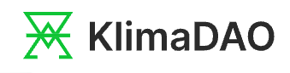









Carbon Explorers
Carbon-backed currency
DeFi Integrations
Consumer Offsetting
We are enabling an ecosystem of regenerative innovation.
Return Protocol
SushiSwap
ReFi OGs
Metaverse + NFTs
carbonized.xyz
Moss Brasil
Atlantis World

Slide 19

Thank you 🙏﻿
Michalis
@Toucan Protocol
Twitter:
@toucanprotocol

